Slide 1
AutoDoc – Intelligent API Documentation and Testing Assistant
Vivek Pankantavita
M25AI1062

Slide 2
Problem Statement
API documentation becomes outdated
Manual documentation is slow
Developers forget to update docs
No test cases are prepared automatically

Slide 3
Solution Overview
AutoDoc automatically:
Extracts FastAPI routes
Generates Markdown documentation
Produces OpenAPI JSON
Creates test cases
Writes summaries (offline pseudo-AI)

Slide 4
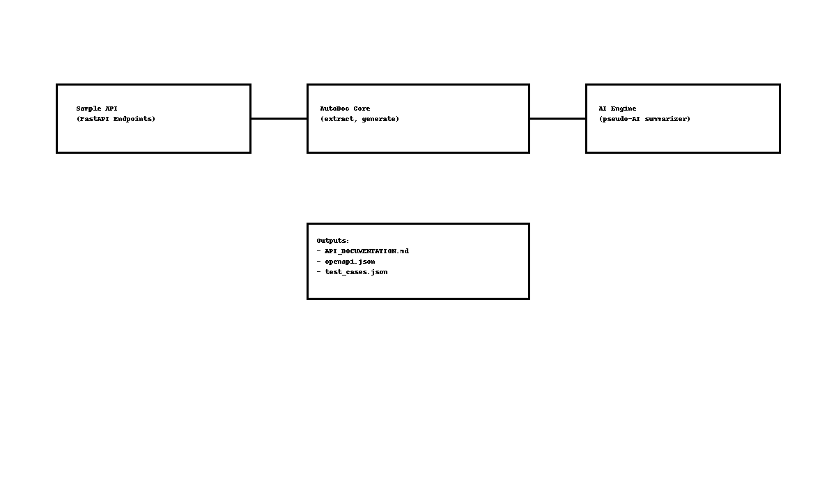
Architecture

Slide 5
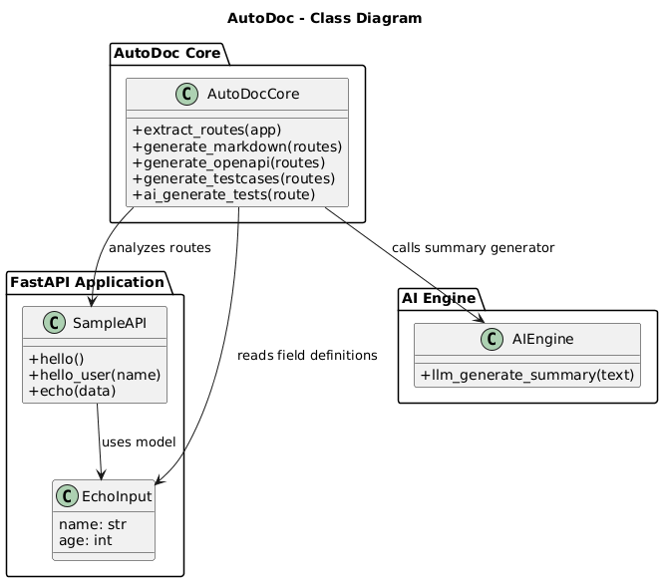
UML

Slide 6
Components
Route Extractor
Documentation Generator
Pseudo-AI Summary Engine

Slide 7
Implementation
Languages/Tools:
Python 3.14
FastAPI
Markdown & JSON generation
Offline summarizer

Slide 8
Modules
sample_api.py – the API
autodoc_core.py – extraction + generation
ai_engine.py – offline summarizer

Slide 9
Endpoints
GET /hello
GET /hello/{name}
POST /echo
Uses Pydantic validation

Slide 10
Outputs
API_DOCUMENTATION.md
openapi.json
test_cases.json

Slide 11
Demo Workflow
Run API
Run AutoDoc
View generated files

Slide 12
Quality Attributes
Maintainability
Reliability
Usability

Slide 13
GIT URL and commits
GIT URL
https://github.com/m25ai1062-spec/AutoDoc
GIT Commits
  a3085c9 (HEAD -> main, origin/main, origin/HEAD) Updated APi documentation
  d3abbcc Updated autodoc core python file
  0d9bb37 Updated sample api accordingly
  dc70851 Updated test cases wit more data
  797e396 Updated folder structure for better visibility
  92ad7d3 Recommit clean repo without openapi secrets and documents
  8ec028a removed all files
  55a91da Initial commit - AutoDoc full commit
  289d27a Initial commit

Slide 14
Conclusion
Saves developer time
Ensures consistency
Works fully offline
Ideal for academic or enterprise use

